Slide 1
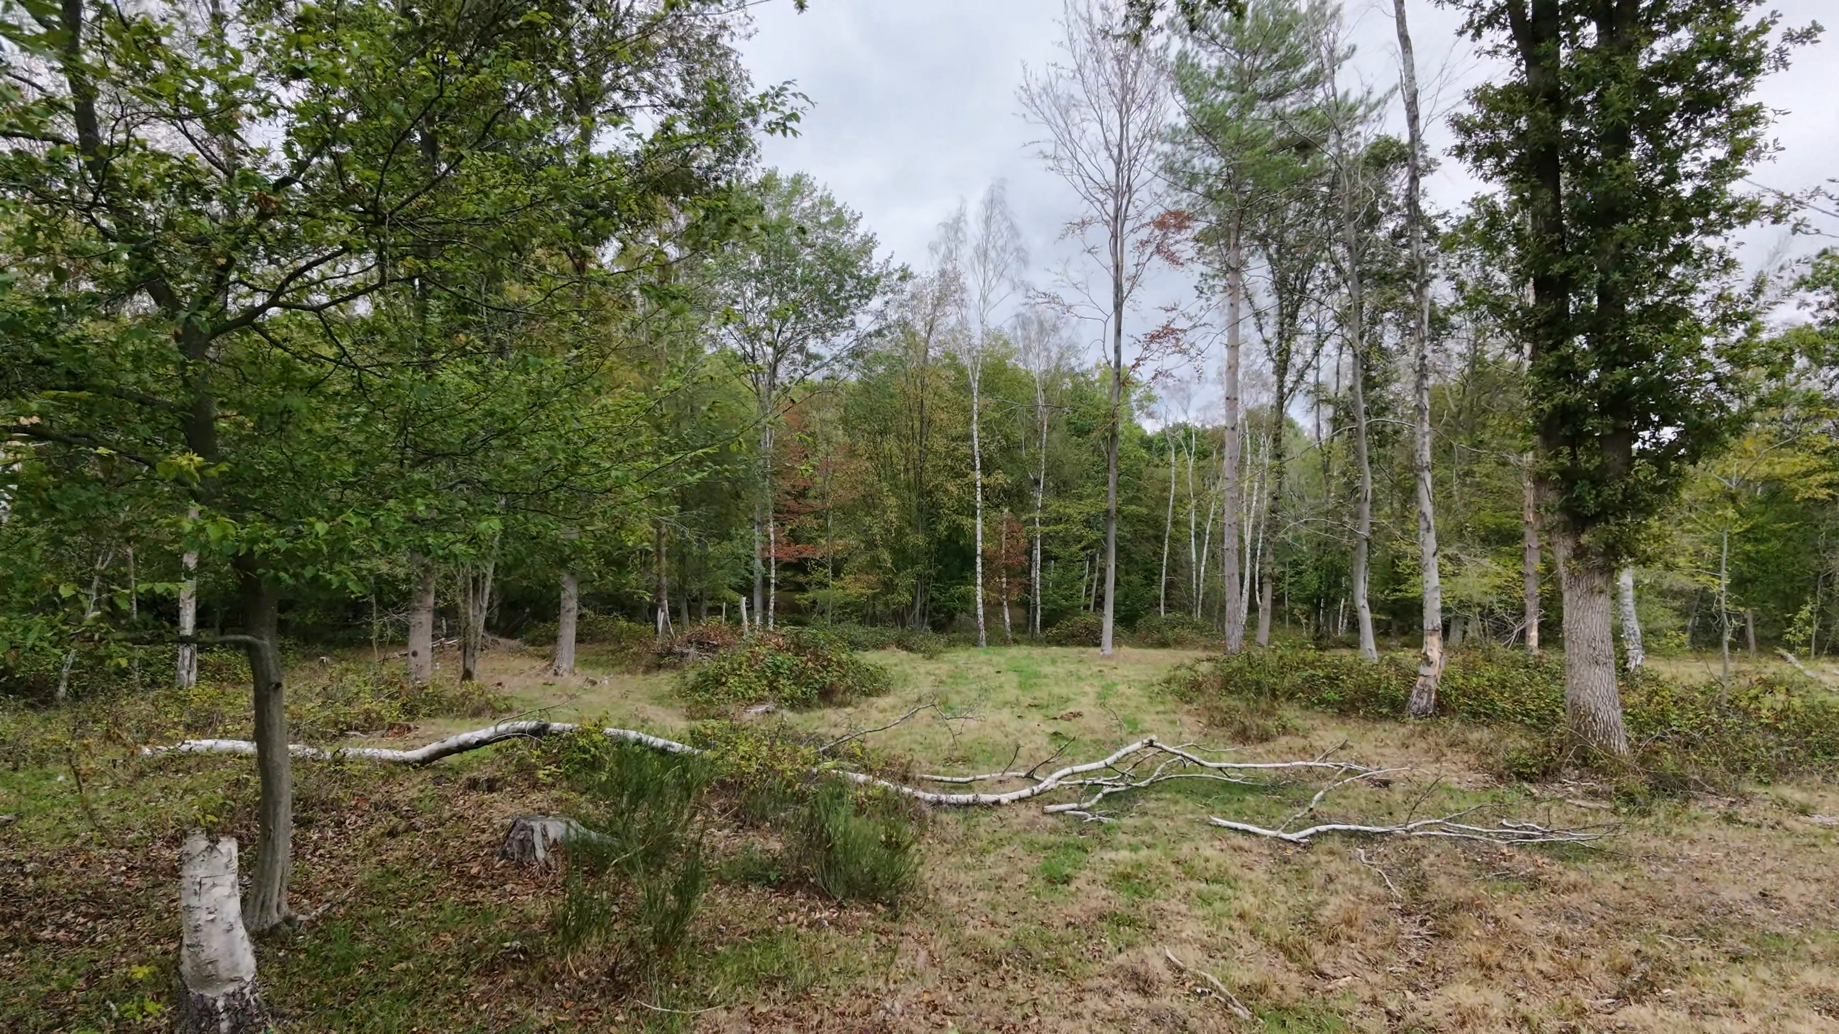
PostFlightStudio · FLIGHT TELEMETRY
Broxbourne Wood, Compartment 6, SSSI
September 13, 2026
Pilot: Georgia Rutherford · 29 September 2026

Slide 2
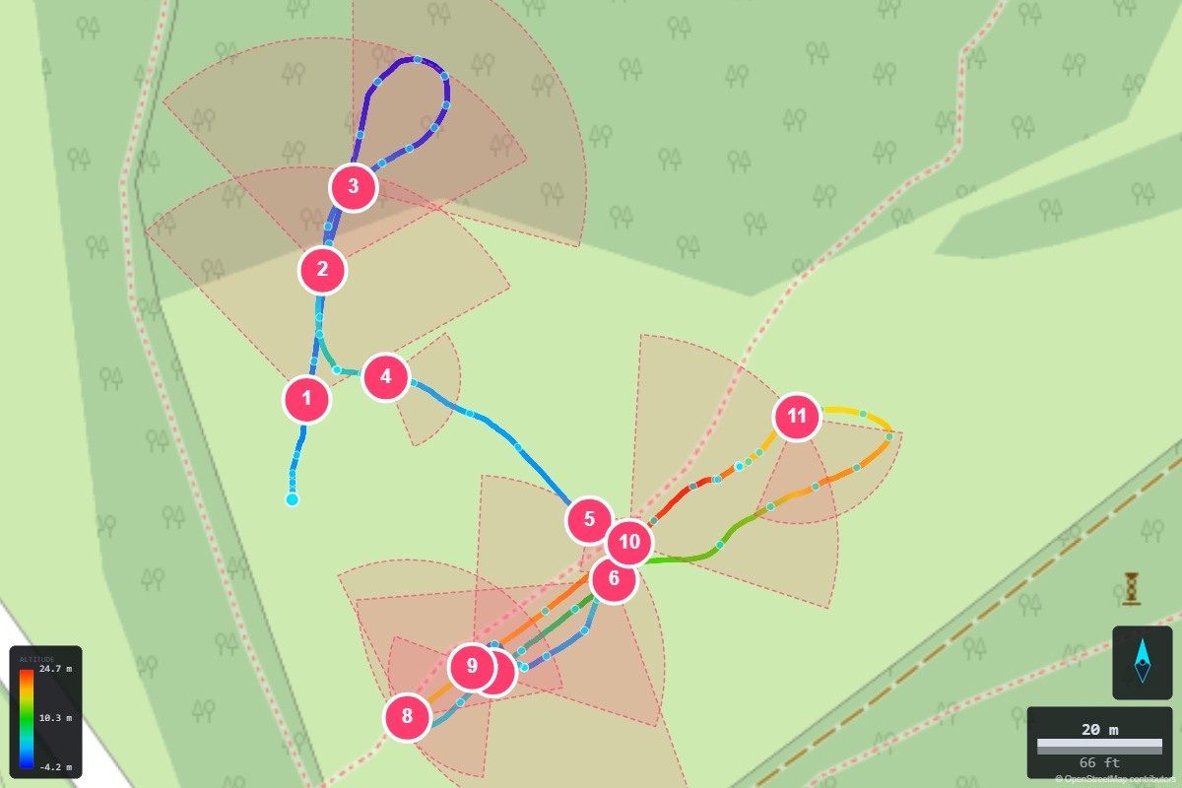
FLIGHT OVERVIEW
TELEMETRY
START TIME
DURATION
3:51:21pm
6:44
MAX ALTITUDE
CAPTURES
24.7 m
11
LOCATION
START LAT
START LON
51.747501
-0.083366
RECOVERY LAT
RECOVERY LON
51.747266
-0.082958
FLIGHT STATS
MAX RANGE
MAX SPEED
93 m
11.9 km/h (7.4 mph)

Slide 3
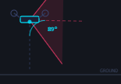
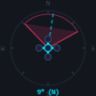
CAPTURE DETAILS
1 / 11
CLOCK
FLIGHT TIME
3:51:46pm
0:25
LAT
LON
51.747645
-0.083332
CAM PITCH
CAM YAW
89° nadir
9° N
ALT
0.2 m
NOTES
Representative view of the w1h (other woodland, mixed) habitat type on the western boundary of Broxbourne Wood, bordering the grazing compartment.
1

Slide 4
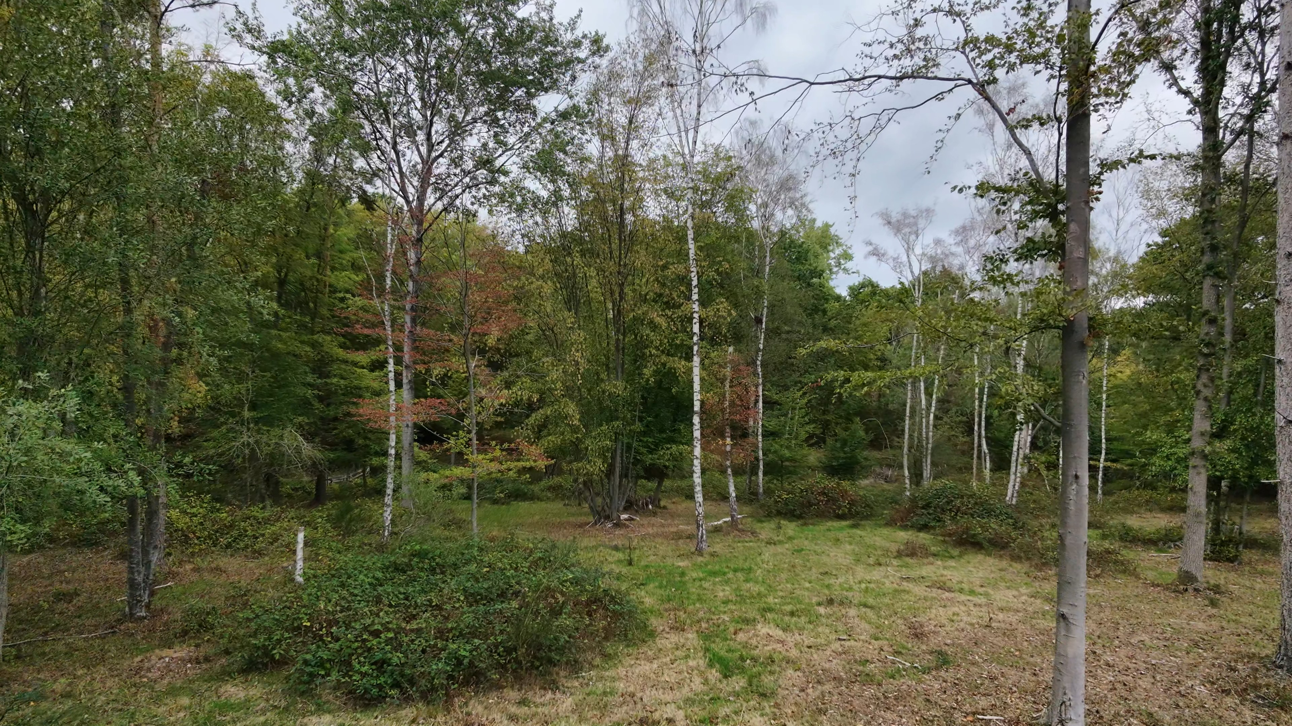

CAPTURE DETAILS
2 / 11
CLOCK
FLIGHT TIME
3:52:01pm
0:40
LAT
LON
51.747831
-0.083295
CAM PITCH
CAM YAW
89° nadir
9° N
NOTES
Interior view of Compartment 6's peripheral woodland zone, highlighting structural diversity and understory.
2

Slide 5
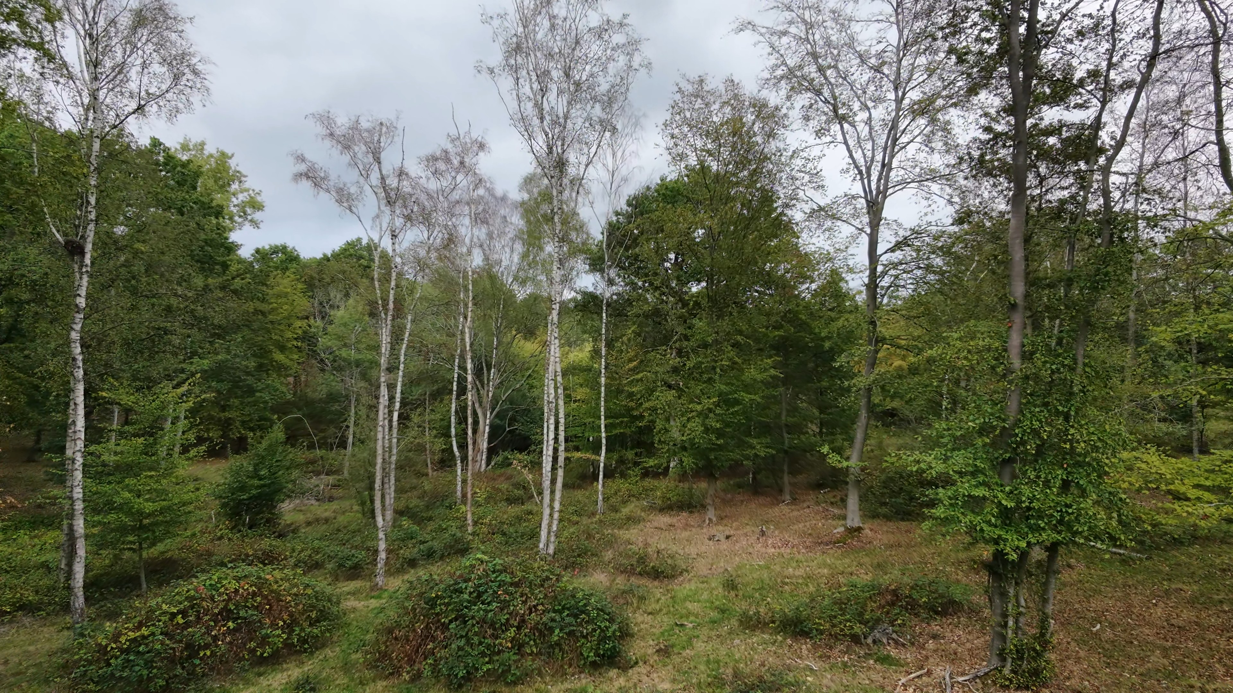
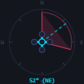
CAPTURE DETAILS
3 / 11
CLOCK
FLIGHT TIME
3:52:16pm
0:54
LAT
LON
51.747950
-0.083223
CAM PITCH
CAM YAW
89° nadir
52° NE
NOTES
Mixed woodland canopy featuring slender silver birch (Betula pendula) poles and mature oak standards, with a ground layer of colonising bramble.
3

Slide 6
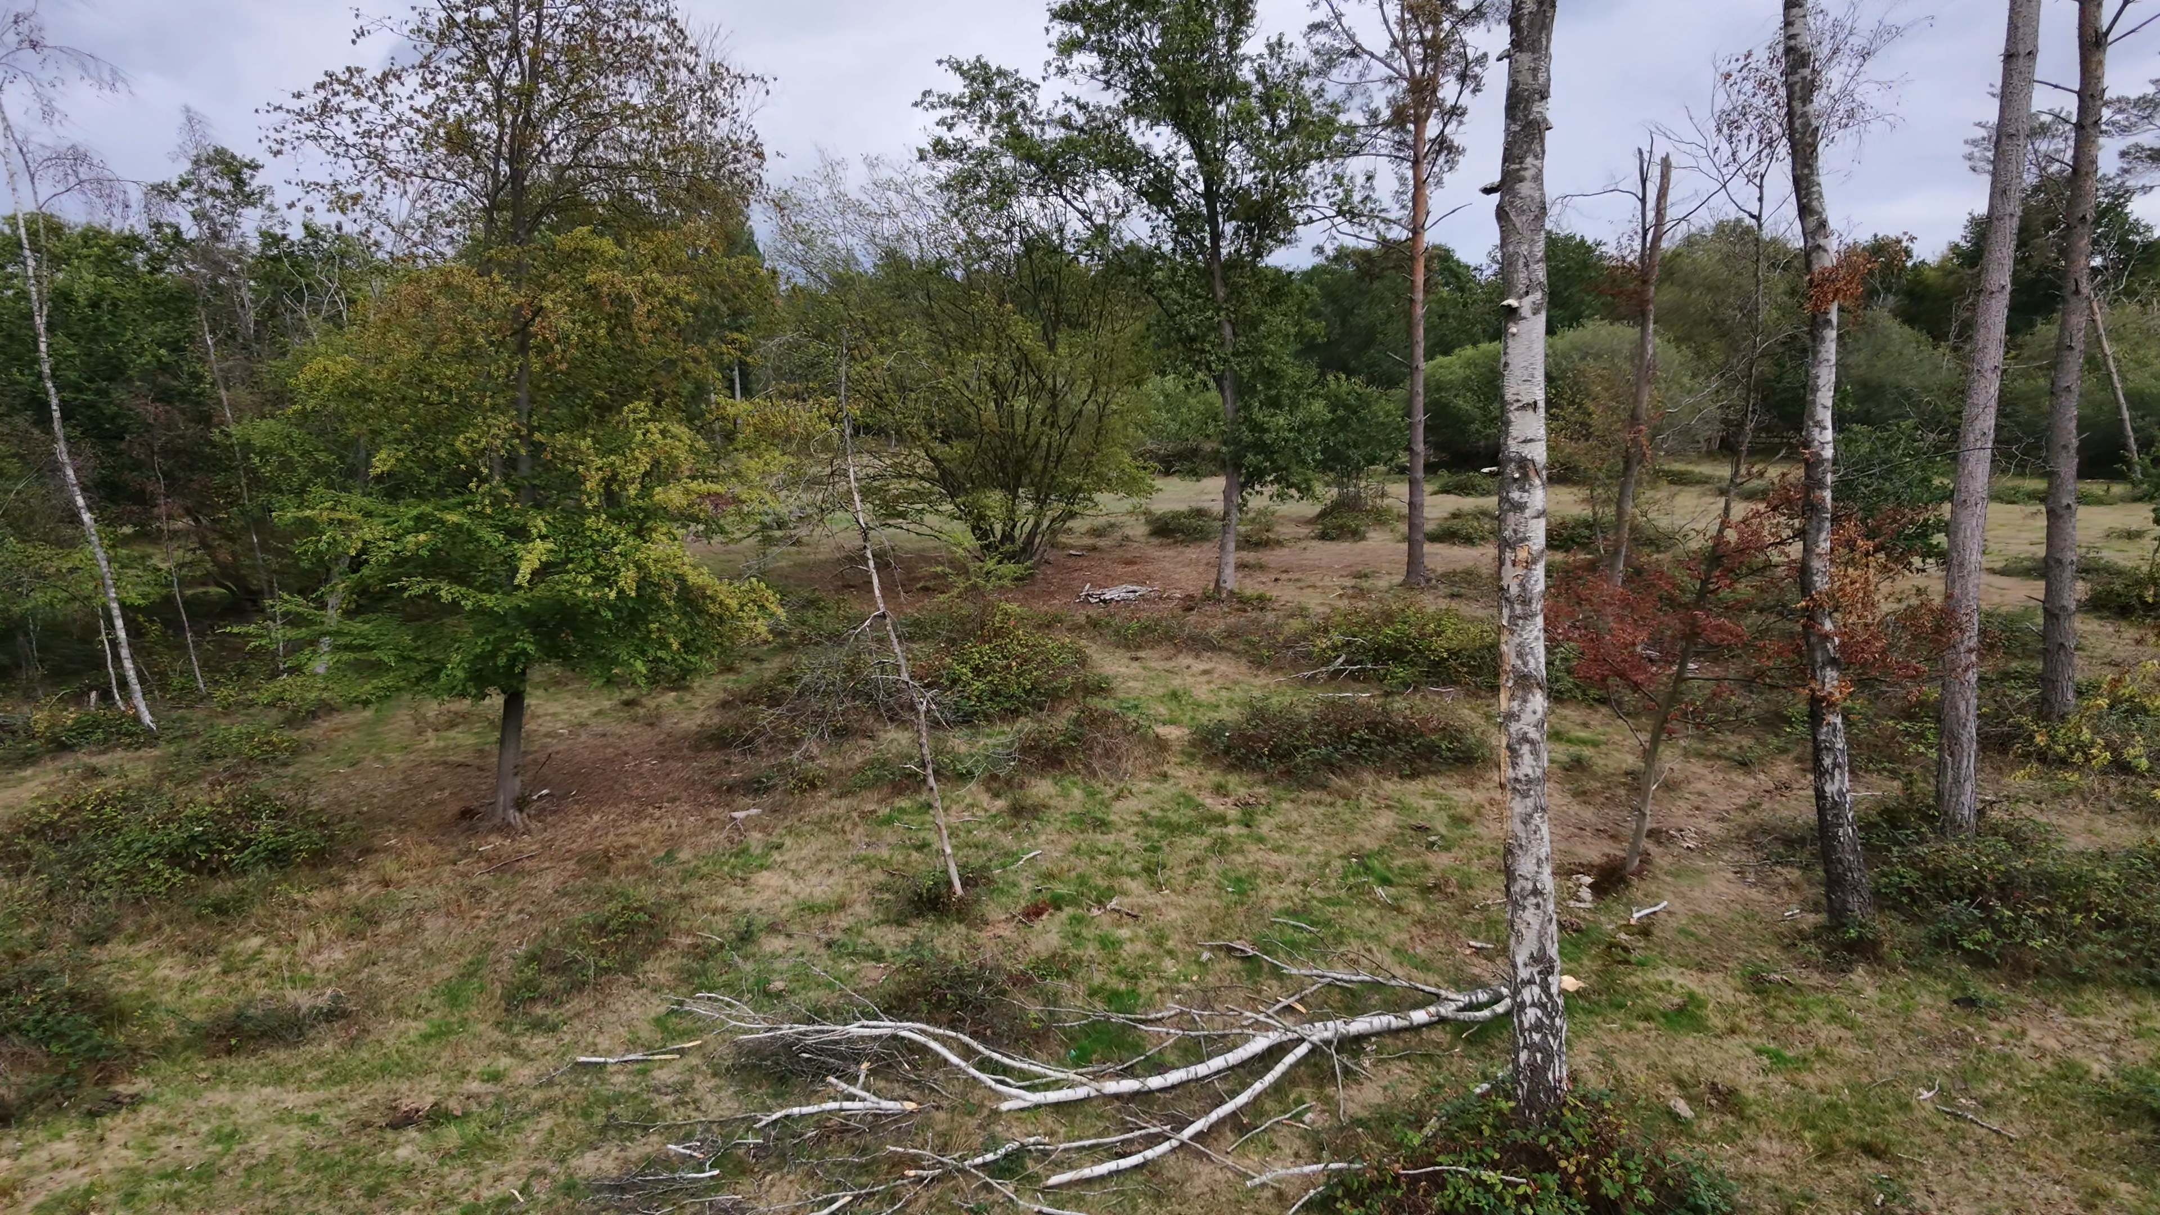
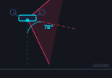
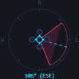
CAPTURE DETAILS
4 / 11
CLOCK
FLIGHT TIME
3:53:48pm
2:27
LAT
LON
51.747677
-0.083148
CAM PITCH
CAM YAW
78° nadir
106° ESE
ALT
3.2 m
NOTES
Transition looking back into the recovering SSSI wood pasture restoration zone, showing scattered retained standards, birch poles, and cleared ground.
4

Slide 7
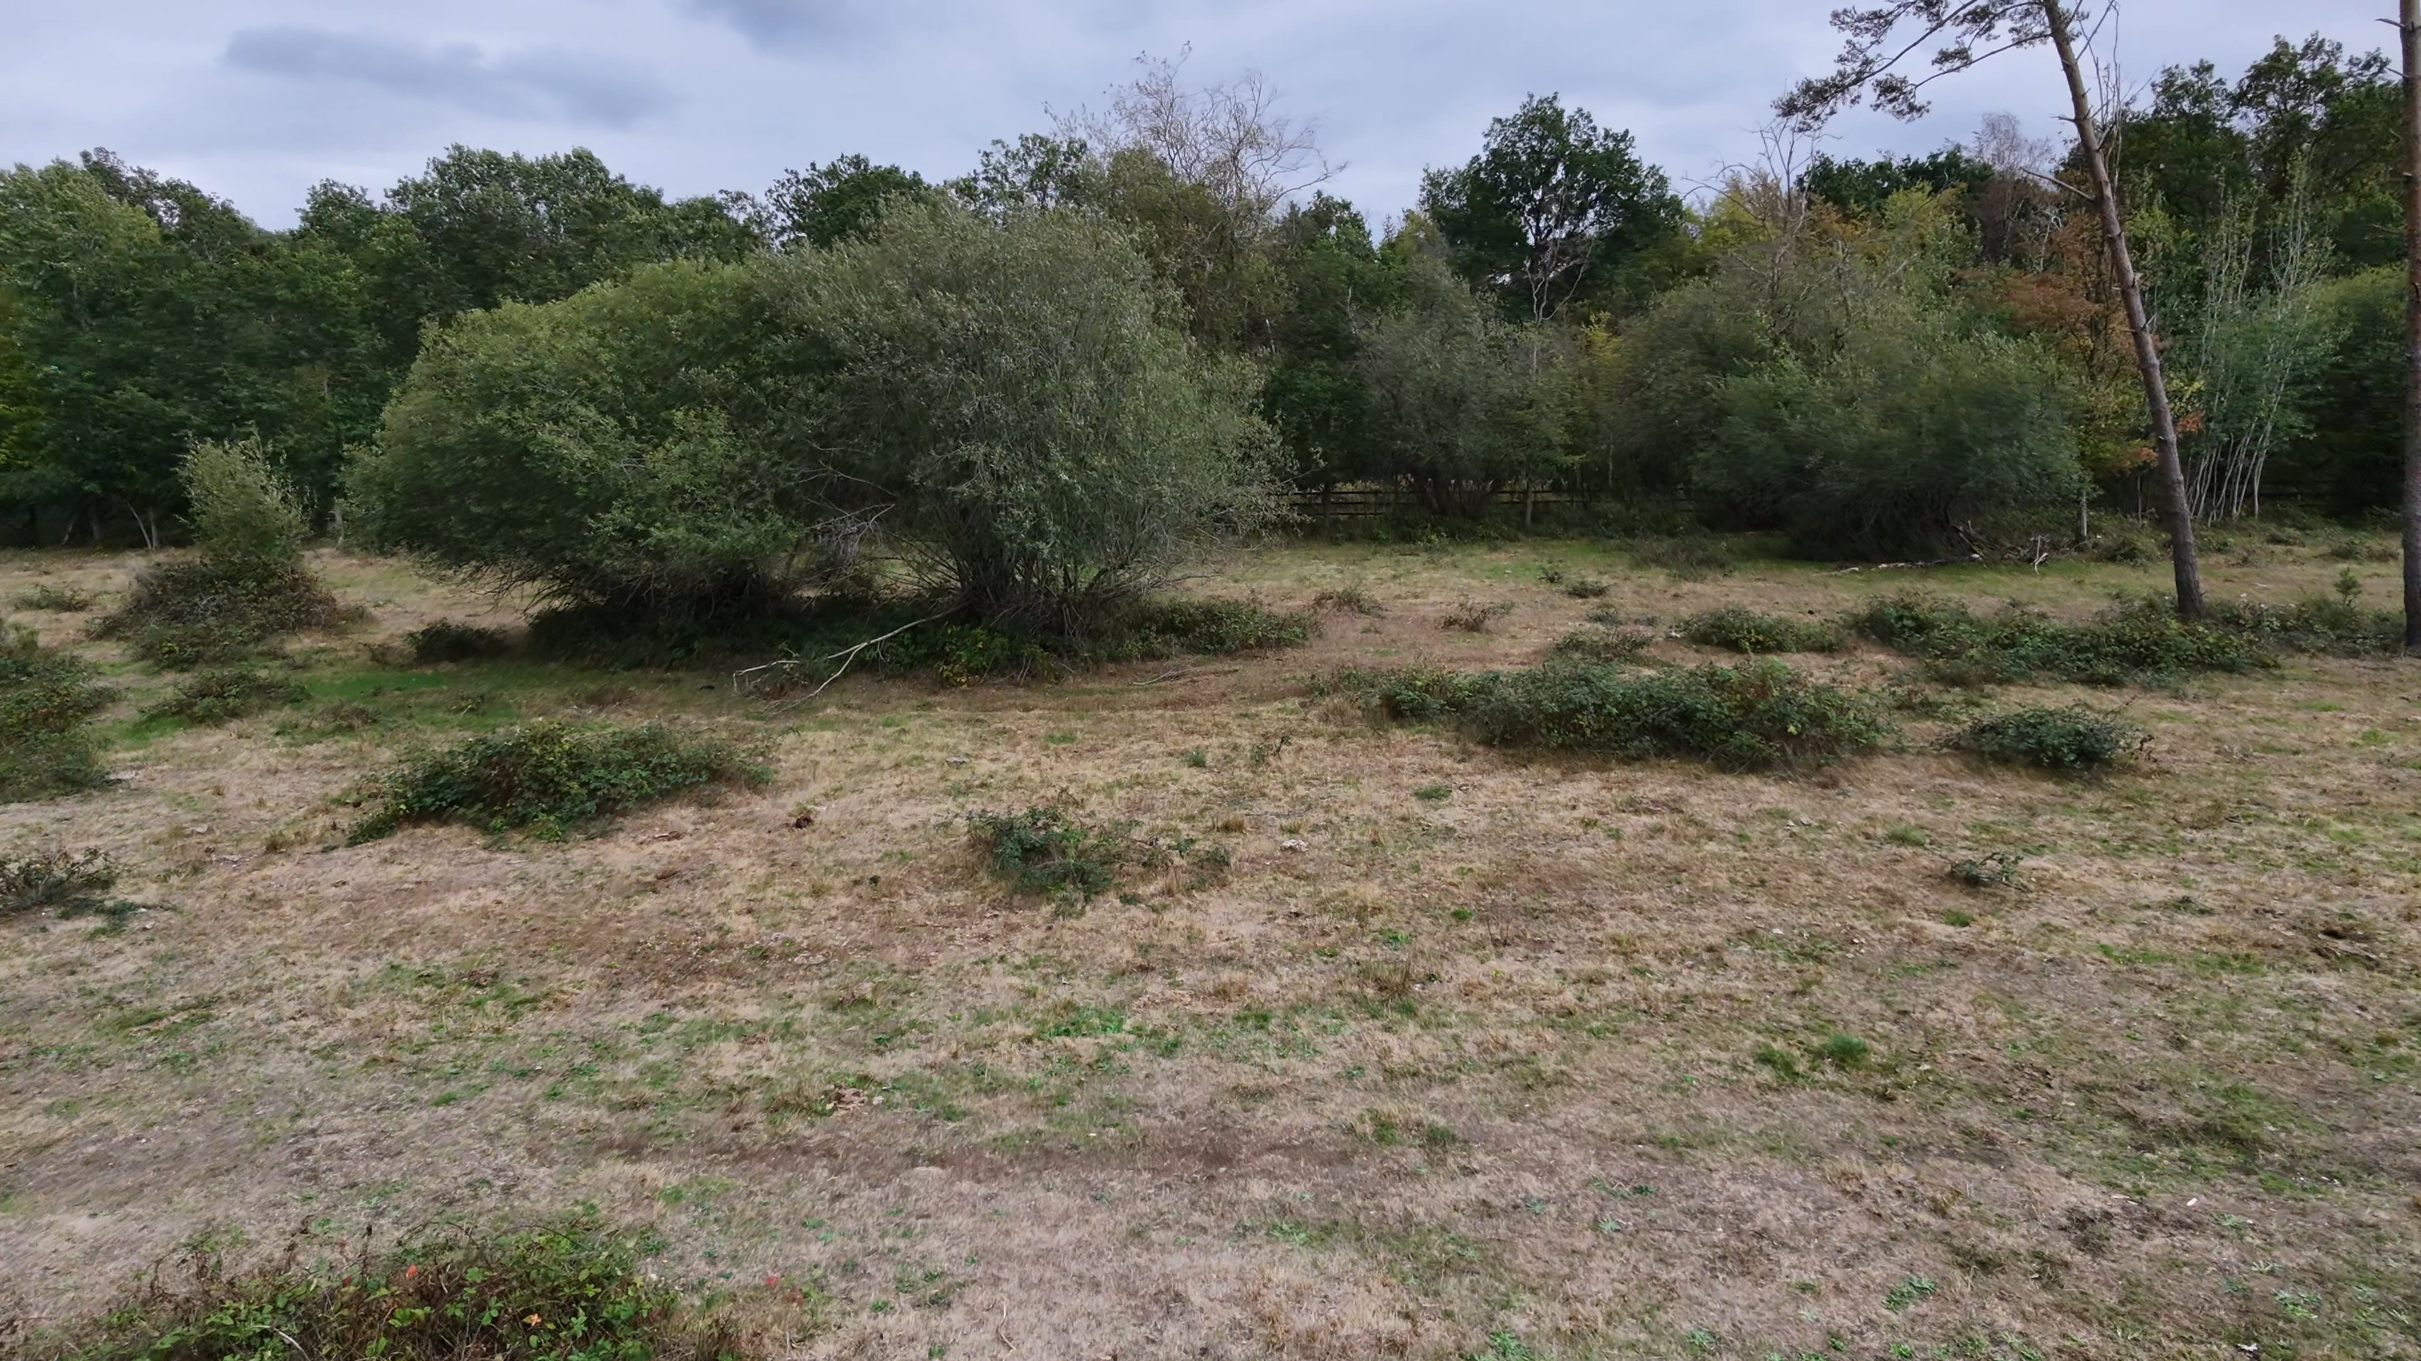

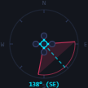
CAPTURE DETAILS
5 / 11
CLOCK
FLIGHT TIME
3:54:07pm
2:46
LAT
LON
51.747470
-0.082675
CAM PITCH
CAM YAW
78° nadir
138° SE
ALT
2.2 m
NOTES
Open grazing area featuring retained scrub islands. Drought conditions evident.
5

Slide 8
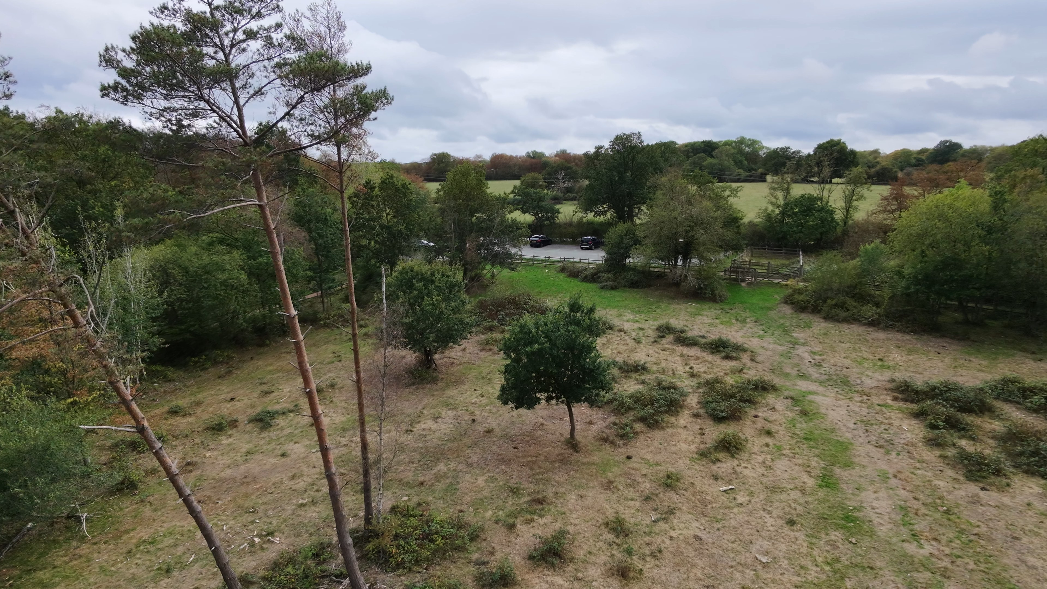

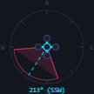
CAPTURE DETAILS
6 / 11
CLOCK
FLIGHT TIME
3:54:19pm
2:58
LAT
LON
51.747386
-0.082618
CAM PITCH
CAM YAW
78° nadir
213° SSW
ALT
11.1 m
NOTES
Looking south-southwest across the SSSI grazing compartment toward the West Car Park access point.
6

Slide 9
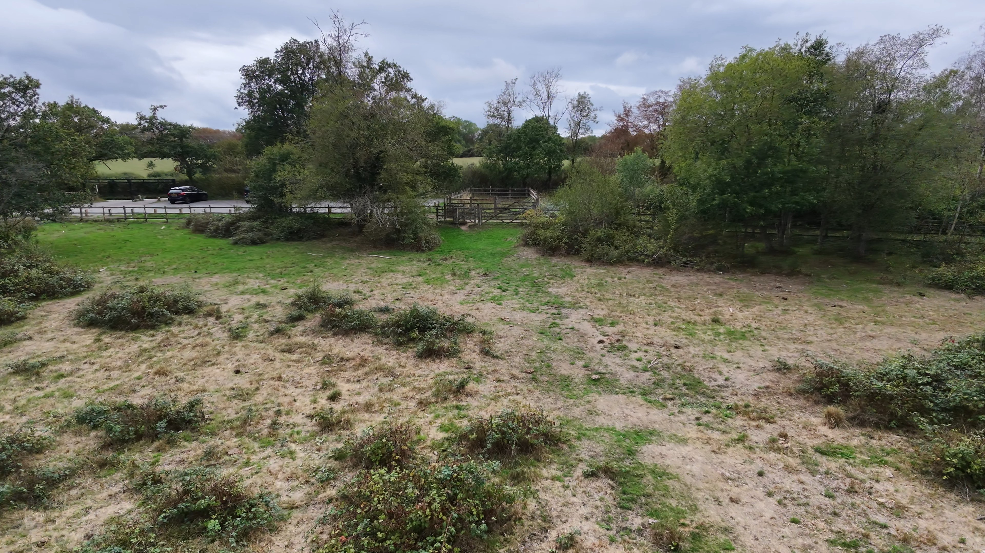

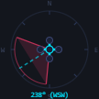
CAPTURE DETAILS
7 / 11
CLOCK
FLIGHT TIME
3:54:33pm
3:12
LAT
LON
51.747252
-0.082899
CAM PITCH
CAM YAW
78° nadir
238° WSW
ALT
4.5 m
NOTES
Southwestern edge of the grazing compartment, View toward the West Car Park access and timber fencing/gate infrastructure bounding Compartment 6.
7

Slide 10
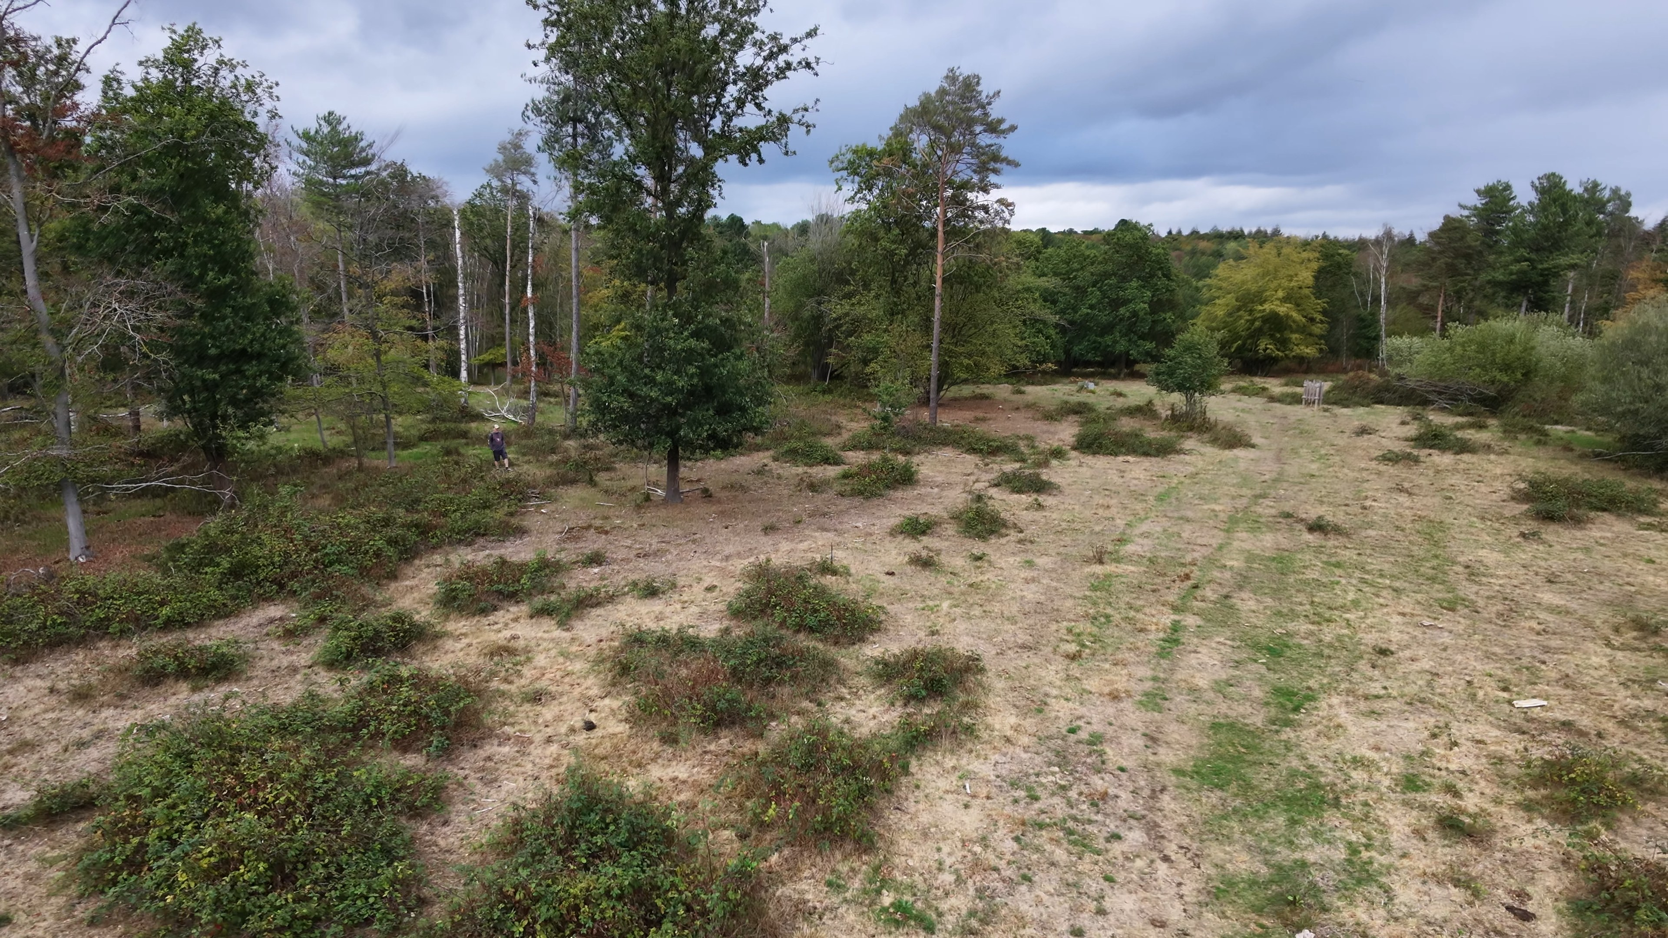

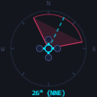
CAPTURE DETAILS
8 / 11
CLOCK
FLIGHT TIME
3:54:52pm
3:31
LAT
LON
51.747187
-0.083098
CAM PITCH
CAM YAW
78° nadir
26° NNE
ALT
6.8 m
NOTES
Overview of Compartment 6 looking north-northeast, illustrating the developing mosaic of acid grassland and recovering scrub under late summer conditions.
8

Slide 11
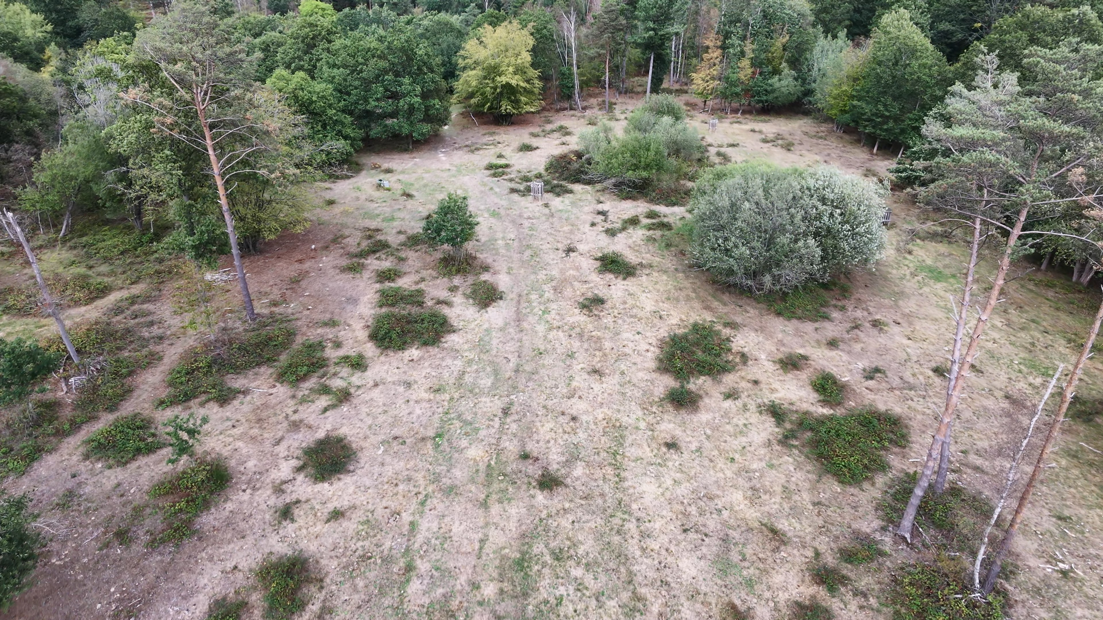
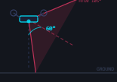
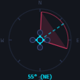
CAPTURE DETAILS
9 / 11
CLOCK
FLIGHT TIME
3:55:10pm
3:49
LAT
LON
51.747259
-0.082947
CAM PITCH
CAM YAW
60° nadir
55° NE
ALT
17.7 m
NOTES
Overview of Compartment 6 looking northeast, illustrating the dry channel alignment of the Spital Brook headwaters during late summer drought conditions.
9

Slide 12
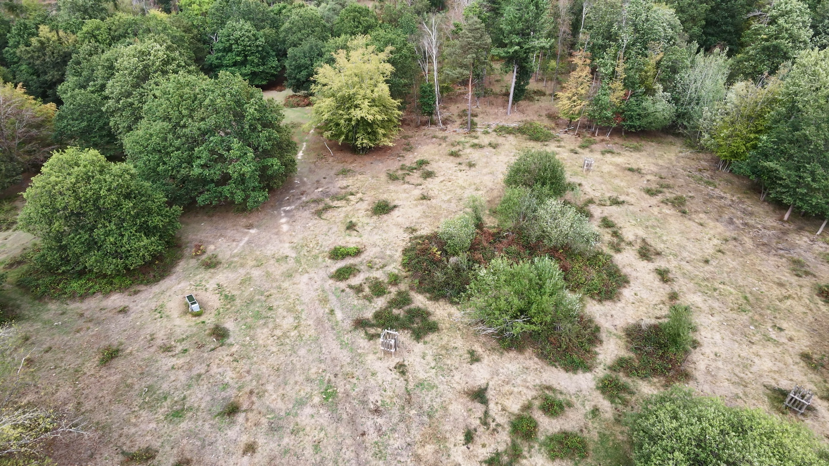
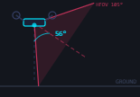

CAPTURE DETAILS
10 / 11
CLOCK
FLIGHT TIME
3:55:23pm
4:02
LAT
LON
51.747438
-0.082582
CAM PITCH
CAM YAW
56° nadir
56° NE
ALT
22.3 m
NOTES
Central grazing compartment featuring newly established tree guards around young planting stock amidst drought-stressed vegetation.
10

Slide 13
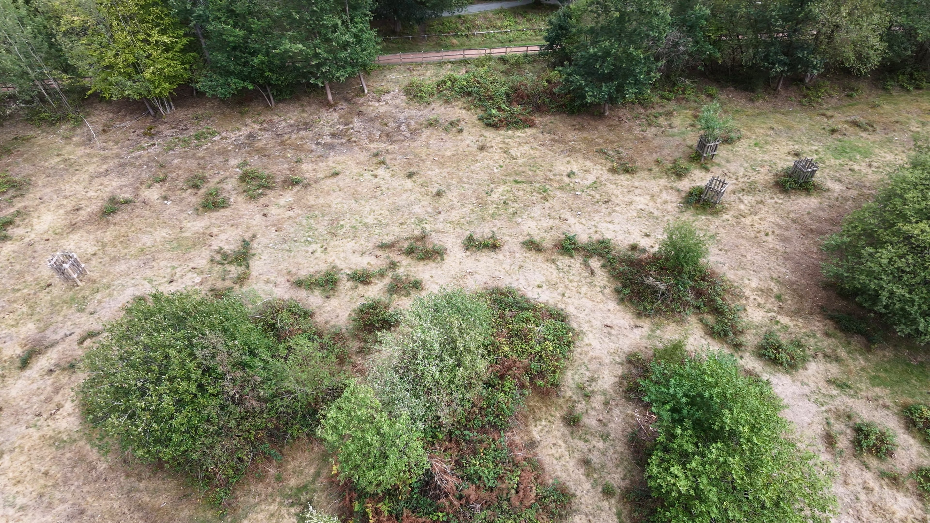
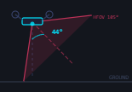
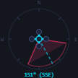
CAPTURE DETAILS
11 / 11
CLOCK
FLIGHT TIME
3:56:28pm
5:07
LAT
LON
51.747620
-0.082192
CAM PITCH
CAM YAW
44° nadir
151° SSE
ALT
17.6 m
11

